Slide 1
Automation Tools for CA

Slide 2
BY CA SANJAY JAIN

Slide 3
What is automation ?
Automation is a term for technology applications where human input is minimized.

Slide 4
Why do we need Automation ?
Eliminate errors and risk associated with routine tasks.

Slide 5
Why do we need Automation ?
Make more time to focus on high value initiatives.

Slide 6
Why do we need Automation ?
Integrate and deploy with zero downtime.

Slide 7
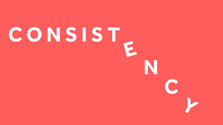
Why do we need Automation ?
Accuracy and Consistency.

Slide 8
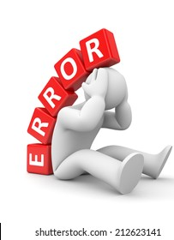
Why do we need Automation ?
Less human error.

Slide 9
Why do we need Automation ?
Increased accountability.

Slide 10
Automation tools we use in our office

Slide 11
Automation tools we use.
Google Forms
YouTube Video
Accounting Automation Tools
pms
Document Management Tools

Slide 12
Google Forms
Collect relevant employee details without any problems
Saves valuable time
Zero Cost

Slide 13
YouTube Video
Helps to handle repetitive tasks
Saves valuable time and reduces stress, not just your but also your team members
Can keep your channel private and can only be shared by links
Zero Cost

Slide 14
Accounting Automation Software
Excel To Tally
Suvit

Slide 15
Document Management Tools
One Drive
Kdoc Plus
Google Drive

Slide 16
Practice Management Tools
Thawk Solutions
CA Dashboard
ERP CA

Slide 17
Audit IN Tally
Paper Less Audit
Verifying Chart of Accounts & Stock items
Data Analysis
Relative Size Factor
Master Configuration
For Related Parties
For Periodic Payment
Creating Samples for Auditing
Auditing Sampled Vouchers
Vouchers Verification dashboard
Exceptional Reports

Slide 18
THANK YOU
CA SANJAY JAIN
PARTNER, J JAIN &COMPANY
CONTACT AT : 9830928057
sanjay@jjainco.com

